Slide 1

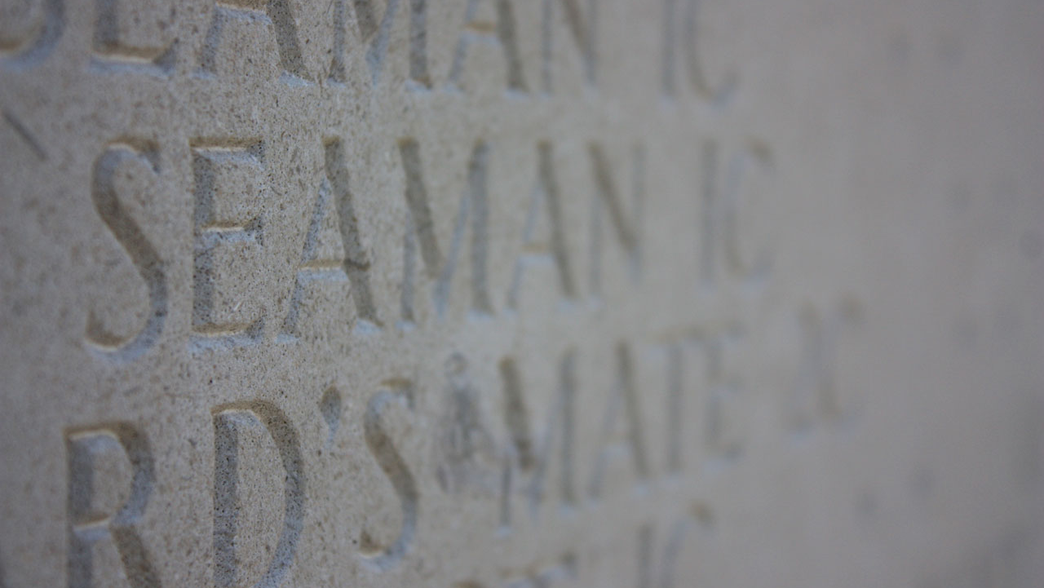
MINI PROJET "Des chiffres et des lettres"
Elaboré par : KTM
Ben Romdhane Karimen | Meriah Tasnim | Maaroufi Mohamed Hedi

Slide 2
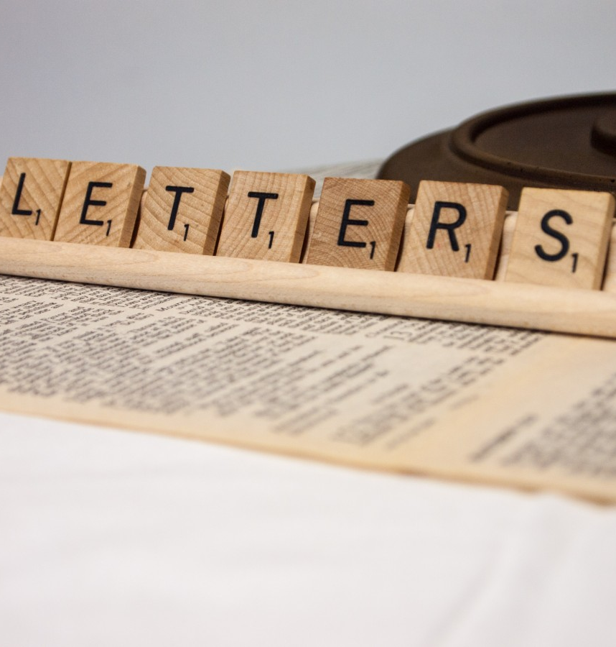
STRUCTURES :
Index_char
player
FUNCTIONS :
Hello()
CleanDict()
CreateIndex()
VerifyIndex ()
EnterName ()
Generate10char ()
chekLetters()
Input()
Timer()
FindWord()
Score()
centerWord()
ShowScore()
Solver()
Manche()
GameOver ()

Slide 3

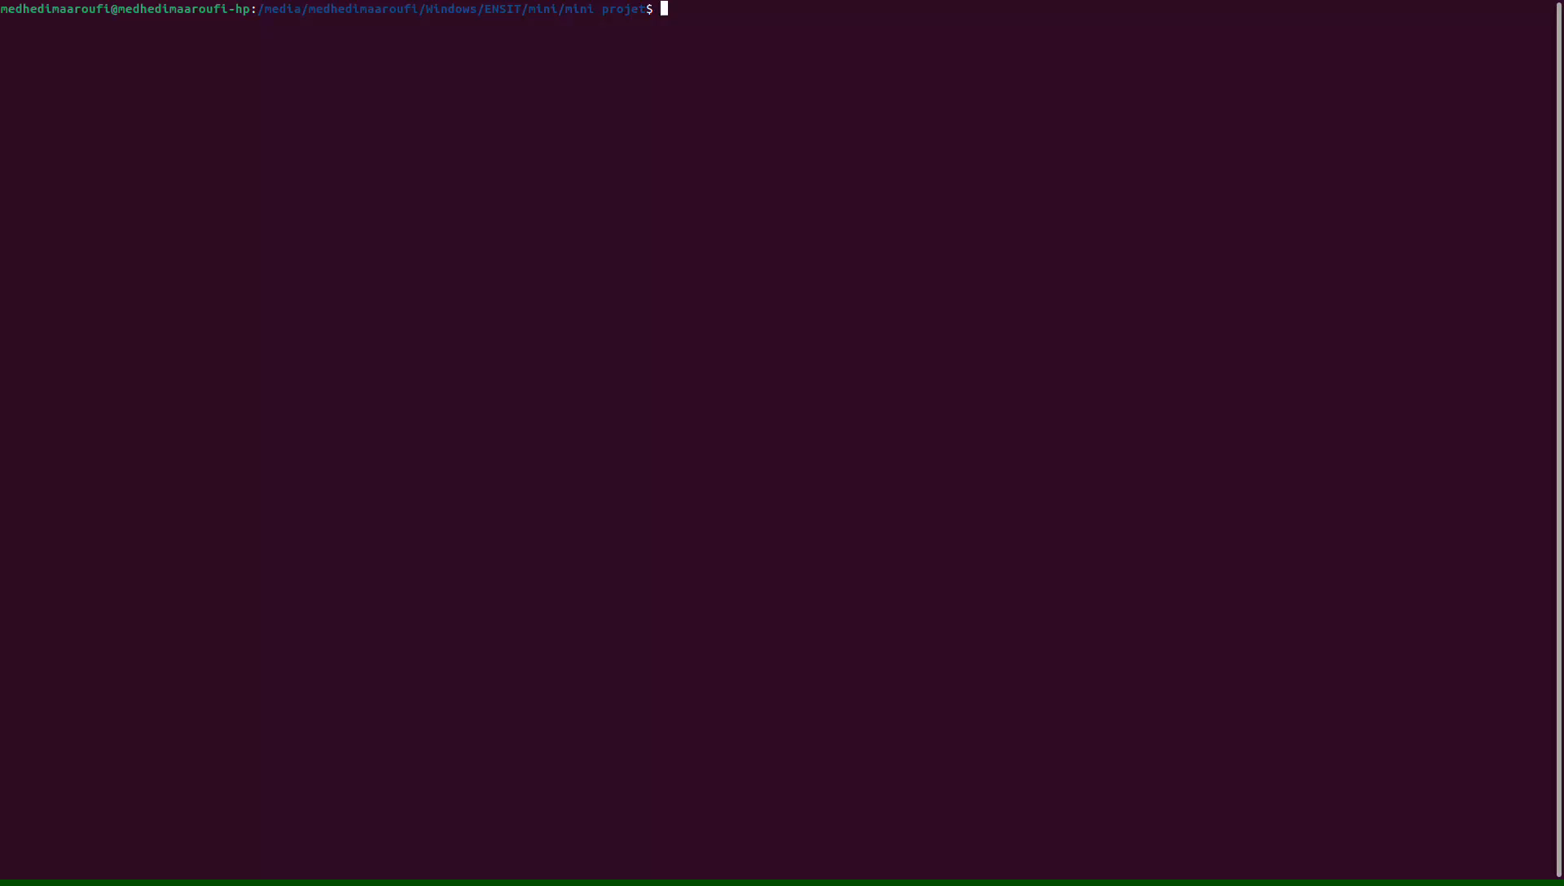
Hello()

Slide 4
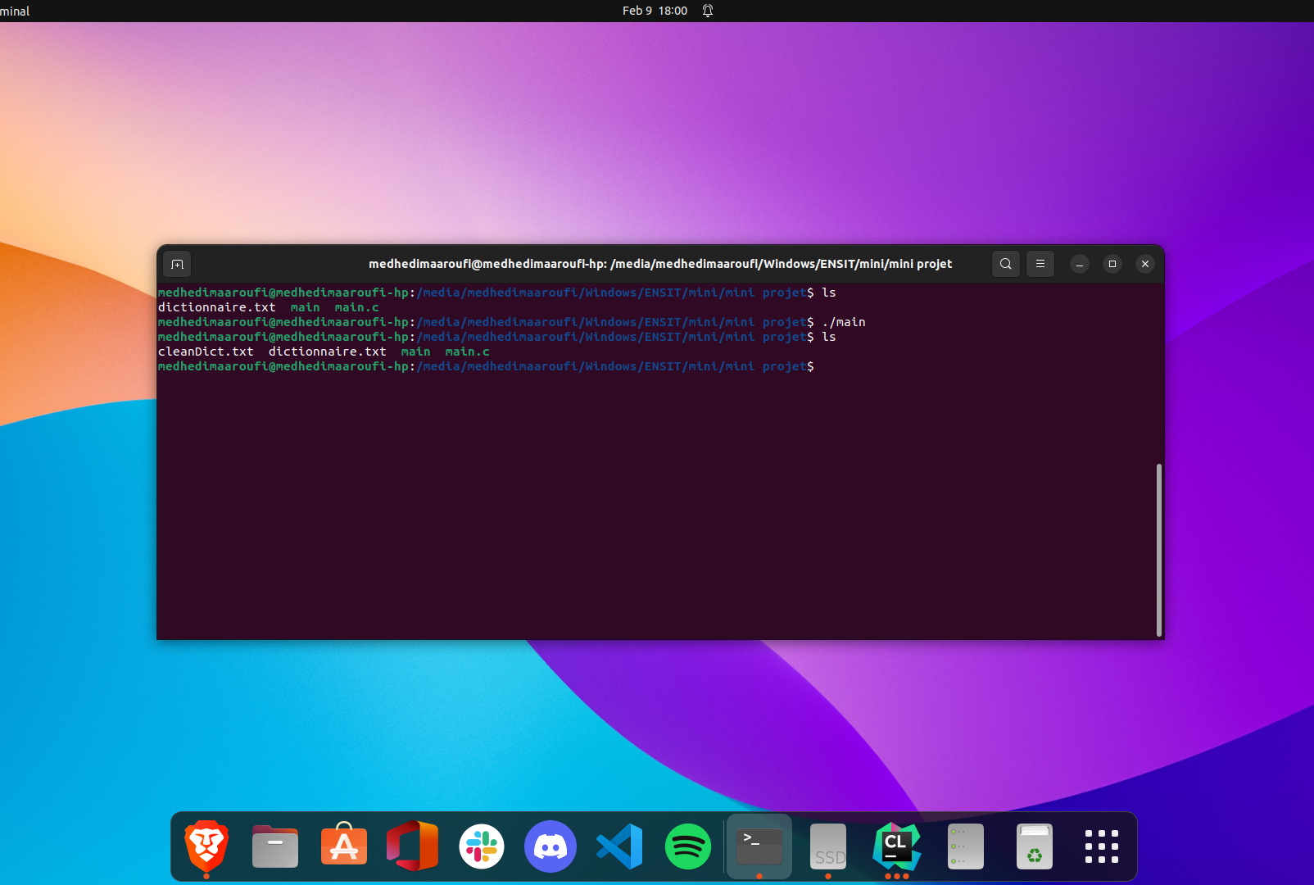
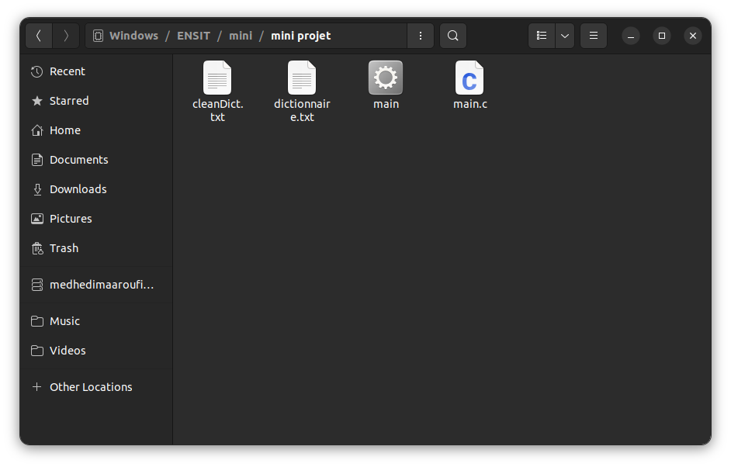
CleanDict()

Slide 5

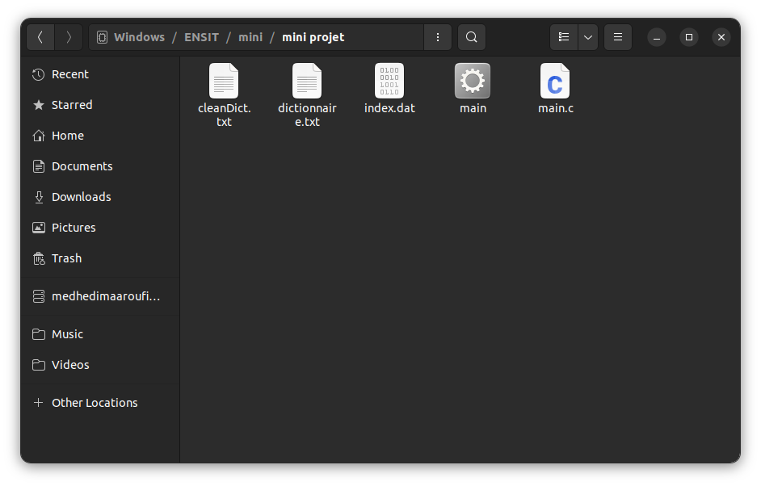
CreateIndex()

Slide 6
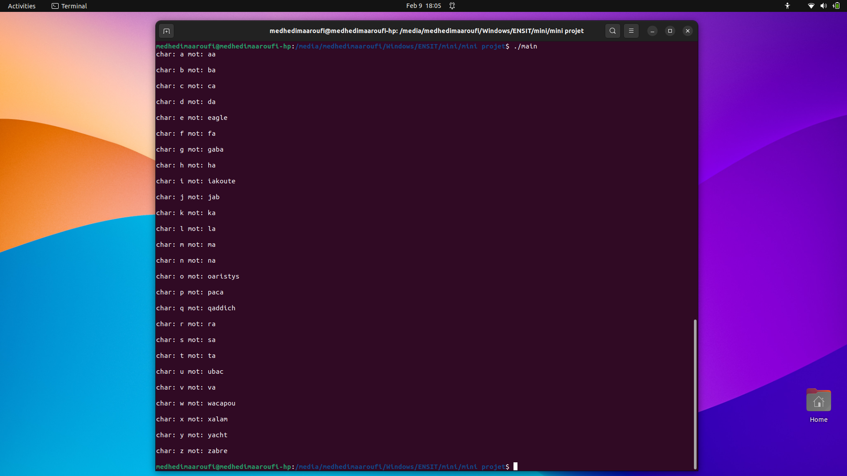
VerifyIndex()

Slide 7
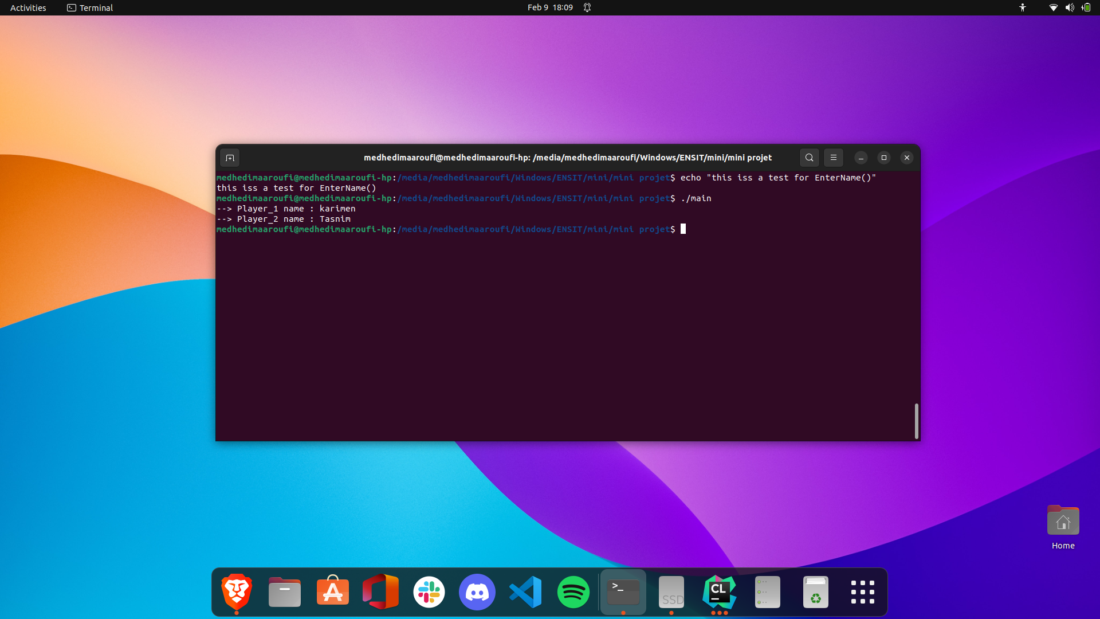
EnterName()

Slide 8
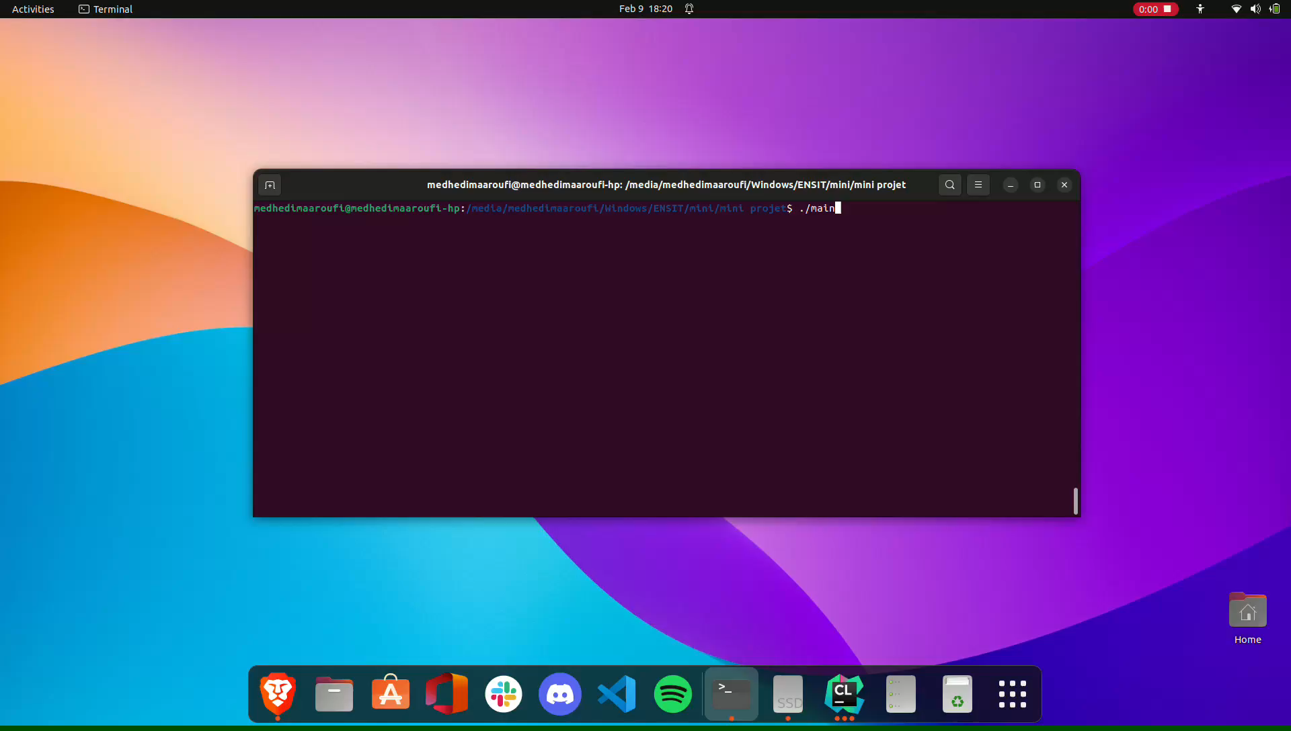
Generate10char ()
chekLetters()
Input()
Timer()
FindWord()
Score()
centerWord()
ShowScore()
Solver()
Manche()

Slide 9

GameOver ()

Slide 10

Merci Pour Votre Attention

